Slide 1
Prostate Cancer Screening and Early Prostate Cancer Management
Dr Marie-Pier St-Laurent, MD, FRCSC
Urologic-Oncology fellow, UBC Research scientist, Vancouver Prostate Centre
Notes:
8 minutes

Slide 2
Disclosures
Honorarium: Bayer, PCSC
As a urologist, I am biased towards prostate cancer screening.
Many thanks to Dr Black for slides content

Slide 3
Objectives
At the end of this presentation, the learners should be able to
Scrutinize the recommendations on prostate cancer screening
Discuss the diagnostic process of prostate cancer
Summarize management options for early prostate cancer

Slide 4
Prostate Cancer Screening – Striking a Balance
Screening reduces the risk of death from prostate cancer.
Screening causes harm: anxiety, infection/bleeding after biopsy, bladder/bowel/ sexual dysfunction after treatment.
The key is to find the correct balance
Shared decision making is the foundation of prostate cancer screening

Slide 5
PSA screening from the patient’s perspective
67 yo male sees new GP because prior GP of 30 yrs retired. DRE and PSA for first time – both abnormal. Diagnosed with high risk prostate cancer with lymph node involvement. “I am so angry - why did my doctor not screen earlier!!!”
78 yo male with coronary artery disease and COPD, found to have elevated PSA. Prostate biopsy negative but patient spends 7 days in ICU with post-biopsy sepsis. “Doctor, why did I have to go through this?!?”
69 yo male diagnosed w/ intermediate risk prostate cancer based on PSA 6. Radical prostatectomy revealed organ confined cancer. Post-op incontinent (diapers!) and impotent.
“I am so grateful – PSA saved my life!!!”
Mr. Gupta
Mr. Choi
Mr. Delmar

Slide 6
Gauging the audience
Which best captures your attitudes on prostate cancer (PCa) screening?
I rarely screen for Pca.
I screen routinely men in appropriate age group.
I am selective to whom I offer PCa screening.

Slide 7
If clinical trial data is extrapolated to whole population and average life expectancy, how many men need to be screened to save one life?
100
250
500
1000
2000

Slide 8
Seven criteria of a good screening test:
1. Disease significantly impacts public health
2. Disease is of adequate prevalence
3. Detection by screening before clinical dx
4. Screening test highly sensitive and specific
5. Screening test tolerated by patient
6. Treatment options available if disease found
7. Earlier treatment leads to improved outcome
Based on Wilson JMG, Jungner G. World Health Organization; 1968.

Slide 9
Why Screen for Prostate Ca?
Most common male cancer.
No symptoms until locally advanced or metastatic.
Multiple effective treatments available to cure early stage prostate cancer.
We have an inexpensive and non-invasive test (PSA) that facilitates early detection.
Screening has been shown to reduce prostate cancer specific mortality in large RCT.

Slide 10
So why the controversy?
Performance characteristics of PSA are not great.
Evaluation of elevated PSA requires invasive and morbid transrectal prostate biopsy.
Prostate cancer has a very long natural history, so that only about 1 in 6 men diagnosed with prostate cancer will die of prostate cancer.
High risk of overtreatment.
Treatment associated with bladder, bowel and sexual dysfunction.

Slide 11
Risk of death from prostate cancer
Better OS, DFS, MFS (12-18% improvement at 23 years)
Relative risk of death reduce: 0.55 (95% CI 0.41 to 0.74; P<0.001)
NNT to prevent one death from any cause: 8.4
Bill-Axelson et al, NEJM 2018
SPCG-4
Notes:
We randomly assigned 695 men with localized prostate cancer to watchful waiting or radical prostatectomy from October 1989 through February 1999 and collected follow-up data through 2017. Cumulative incidence and relative risks with 95% confidence intervals for death from any cause, death from prostate cancer, and metastasis were estimated in intention-to-treat and per-protocol analyses, and numbers of years of life gained were estimated. We evaluated the prognostic value of histopathological measures with a Cox proportional-hazards model.
RESULTS
By December 31, 2017, a total of 261 of the 347 men in the radical-prostatectomy group and 292 of the 348 men in the watchful-waiting group had died; 71 deaths in the radical-prostatectomy group and 110 in the watchful-waiting group were due to prostate cancer (relative risk, 0.55; 95% confidence interval [CI], 0.41 to 0.74; P<0.001; absolute difference in risk, 11.7 percentage points; 95% CI, 5.2 to 18.2). The number needed to treat to avert one death from any cause was 8.4. At 23 years, a mean of 2.9 extra years of life were gained with radical prostatectomy. Among the men who underwent radical prostatectomy, extracapsular extension was associated with a risk of death from prostate cancer that was 5 times as high as that among men without extracapsular extension, and a Gleason score higher than 7 was associated with a risk that was 10 times as high as that with a score of 6 or lower (scores range from 2 to 10, with higher scores indicating more aggressive cancer).
Bill-Axelson A, Holmberg L, Garmo H, et al. Radical Prostatectomy or Watchful Waiting in Prostate Cancer - 29-Year Follow-up. N Engl J Med. 2018;379(24):2319-2329. doi:10.1056/NEJMoa1807801

Slide 12
The Evidence For Screening

Slide 13
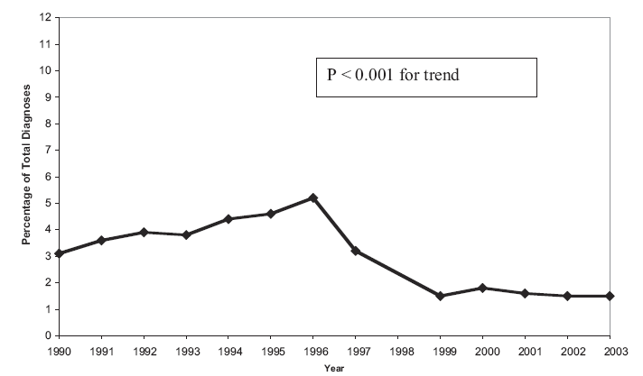
Fewer metastases in PSA era
Rate of bone mets at time of first diagnosis of prostate cancer
Ryan CJ et al. Urol Oncol. 2006 Sep-Oct;24(5):396-402.
(CaPSURE database)
Notes:
This is data from the CaPSURE database – a community based database of thousands of patients treated for CaP in the US.

Slide 14
Level 1 Evidence
European Randomized Study of Screening for Prostate Cancer (ERSPC)
Prostate, Lung, Colorectal and Ovarian Cancer Screening Trial (PLCO)

Slide 15
ERSPC
PLCO
Trial
1993 - 2005
182,000 men in 8 European countries
Age 50-74 years
Screening q 2-4 yrs vs. no screening
PSA (DRE only for elevated PSA)
16 years follow-up
1993 - 2001
76,693 men in 10 U.S. Centers
Age 55 – 74 years
Annual screening vs. “usual care”*
DRE for 4 years, PSA for 6 years
13 years follow-up
Results
Incidence of prostate cancer increased 1.32x
Screened: 11.5% (=8444)
Control: 8.7% (=7732)
Risk of death from prostate cancer:
20% reduction in screened group (520 vs. 793)
Absolute risk reduction 1.75 death per 1000 men, therefore number needed to screen 570
Number needed to diagnose to save 1 life: 18
Incidence of prostate cancer increased 1.12x
Screened: 11.1% (=4250)
Control: 9.9% (=3815)
Risk of death due to prostate cancer:
9% increase in screened group (158 vs 145) (difference not statistically significant)
*High rate of screening in “usual care” arm:
40% had PSA within 3 years of entering trial
90% had PSA on trial (contamination)
Schroeder et al. NEJM 2009;360(13):1320-1328
Schroeder et al. Lancet 2014;384(9959):2027-35
Schroeder et al. Eur Urol 2019; 76(1): 43–51
Andriole et al, NEJM 2009 360(13):1310-1319
Andriole et al, JNCI 2012 104:125-132
JE Shoag et al, NEJM 2016 374;18
Notes:
ERSPC: 82% of screening group underwent screening
at 16 yr, the NND in the Swedish centre was as low as 7

Slide 16
Reevaluating PSA Testing Rates in the PLCO Trial
90% of patients in control arm had PSA test during trial; 70% within 2 years of trial; 50% within 1 year
men in the control group had similar cumulative PSA testing to men in the intervention group
JE Shoag et al, NEJM 374;18 (2016)
Notes:
Rates of testing during the trial were determined by a follow-up survey, termed the Health Status Questionnaire (HSQ), that was administered to a subgroup of participants in the control group.3 In the HSQ, men were asked whether they had ever undergone a PSA blood test for prostate cancer, along with follow-up questions about when and why the test was performed.
Categorical responses for when the most recent test was performed were within the past year, 1 to 2 years ago, 2 to 3 years ago, more than 3 years ago, and do not know, and responses for the main reason for the test were because of a specific prostate problem, follow-up to a previous health problem, and part of a routine physical examination. In the landmark 2009 trial report, the rate of
testing in the control group was limited to men who responded that they had been tested within the previous year as part of a routine physical examination, and other responses were not counted
as testing
Subsequent letter to editor revealed that the 90% refers to screening outside of the trial – so the number was lower in men in the screening arm because they were screened in trial. Adding inside and outside trial PSA would give 99% in screened arm. The 90% was apparently also published earlier – the 52% in original report was intended to be an annual screening rate – not cumulative

Slide 17
The relative benefit increases over time
In order to save one life:
 | number needed to screen | number needed to diagnose
9 years | 1410 | 48
11 years | 1055 | 37
13 years | 781 | 21
16 years | 570 | 18
25 year estimate* | 186-220 | 2-5
lifetime estimate# | 98 | 5
* Gulati et al, J Clin Epidemiol. 2011; 64(12): 1412–1417
# Heijnsdijk et al, NEJM Aug 16, 2012
Notes:
As time past from initial publication of the trial, the benefit of screening (with longer latency) as showed more benefit on the outcome

Slide 18
Incidence of de novo metastatic cancer
HG Welch, DH Gorski, PC Albertsen.
N Engl J Med 2015; 373:1685-1687
October 29, 2015
USPSTF Grade B
USPSTF
Grade D
Notes:
The inconsistencies of the USPSTF are highlighted by this figure from a very recent publication in the New England Journal
breast cancer women 40 and older
prostate cancer men 40 and older
a metric that includes only cases in which cancer is first diagnosed when a patient presents with metastases, not those in which early-stage cancer is diagnosed and then progresses to metastatic disease
The incidence of metastatic breast cancer has been stable since 1975 (see graph). In contrast, the incidence of metastatic prostate cancer has decreased by half since 1988. Although SEER data aren't available for earlier years, data from the Seattle–Puget Sound registry suggest that the incidence of metastatic prostate cancer was stable before 1988.
Breast: Either mammography isn't sensitive enough to identify these cancers early or they don't fit the Halstedian paradigm of steady progression. The lack of change in the incidence of metastatic disease is consistent with the hypothesis that breast cancer is a systemic disease by the time it's detectable — a paradigm typically attributed to Bernard Fisher.
Prostate: Although the decline in the incidence of metastatic disease could have been caused by an intervention to reduce prostate cancer risk or a reduction in an environmental carcinogen, for example, it's hard to imagine another factor changing and exerting an effect so quickly. Data on patient age further support the hypothesis that PSA screening leads to earlier diagnosis of cancers destined to become metastatic: the mean age at diagnosis for men 40 years of age or older has fallen by 2 years, from 71.8 to 69.8 years.

Slide 19
US Preventive Services Task Force 2012
Prostate cancer screening “downgraded”:
Prior to 2012:
Grade C: not enough evidence to recommend or discourage PSA screening (i.e. shared decision making)
After 2012:
Grade D: PSA screening causes more harm than benefit (i.e. do not screen)

Slide 20
Criticisms of the USPSTF Grade D Report
Underestimated benefits and overstated harms
Overlooked contamination flaws of PLCO trial
Ignored short f/u of ERSPC trials (2009 reports)
Placed little weight on longer-term Göteberg (Swedish) trial
Focused almost solely on mortality data
Did not consider morbidity of advanced prostate cancer
Did not account for increased use of active surveillance for low-risk prostate cancer that reduces harm associated with prostate cancer Dx
Moyer VA, on behalf of the US Preventive Services Task Force. Ann Intern Med 2012;157:120-34; Andriole GL, et al. New Engl J Med 2009;360:1310-9; Schröder FH, et al. N Engl J Med 2009;360:1320-8; Hugosson J, et al. Lancet Oncol 2010; 11:725-32
Notes:
But let’s come back to the Task Force statement. The criticism from people like myself is that …..

Slide 21
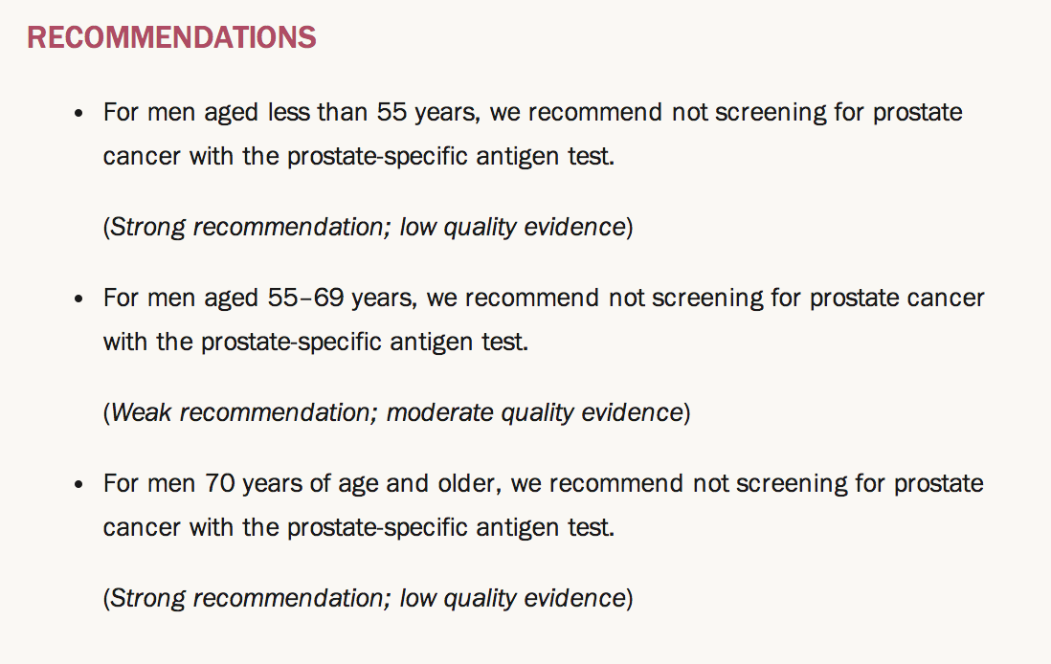
Canadian Task Force 2014
DO NOT SCREEN
DO NOT SCREEN
DO NOT SCREEN
CMAJ Oct 27, 2014
Available online, content unchanged (Oct 10th, 2023)
Notes:
This clinical practice guideline has been endorsed by the College of Family Physicians of Canada (CFPC).
self appointed group of non-content experts
recapitulate US Task Force
targets an overtreatment problem that we do not have
uncoupling diagnosis from treatment

Slide 22
Preventive Services Task Force

Slide 23
Age Adjusted Incidence 5 yr after USPSTF recommend against screening (2008 and 2012)
Jemal A et al, J Natl Cancer Inst 2020
Notes:
we examined temporal trends in invasive prostate cancer incidence from 2005 to 2016 in men aged 50 years and older stratified by stage. Based on the US Cancer Statistics Public Use Research Database
incidence for local-stage disease declined beginning in 2007.
In contrast, incidence for regional- and distant-stage disease increased in both age groups during the study period.
For example, distant-stage incidence in men aged 75 years and older increased by 5.2% (95% CI = 4.2% to 6.1%) per year from 2010 to 2016.

Slide 24
Increased incidence of high stage PCa since 2012
T3/T4 prostate cancer
Metastatic prostate cancer
SEER Database
M Desai et al, JAMA Networks 2022

Slide 25
US Preventive Services Task Force 2017
Prostate cancer screening “upgraded”
back to grade “C” = not enough evidence to recommend or discourage
“For men aged 55 to 69 years, the decision to undergo periodic PSA-based screening for prostate cancer should be an individual one and should include discussion of the potential benefits and harms of screening with their clinician. Screening offers a small potential benefit of reducing the chance of death from prostate cancer in some men. However, many men will experience potential harms of screening, including false-positive results that require additional testing and possible prostate biopsy; overdiagnosis and overtreatment; and treatment complications, such as incontinence and erectile dysfunction. In determining whether this service is appropriate in individual cases, patients and clinicians should consider the balance of benefits and harms on the basis of family history, race/ethnicity, comorbid medical conditions, patient values about the benefits and harms of screening and treatment-specific outcomes, and other health needs.”
JAMA 2018

Slide 26
CUA Guidelines recommendations
The CUA suggests offering PSA screening to men with a life expectancy greater than 10 years. The decision of whether or not to pursue PSA screening should be based on shared decision-making after the potential benefits and harms associated with screening have been discussed (Level of evidence: 1; Grade of recommendation: B).
For men electing to undergo PSA screening, we suggest starting PSA testing at age 50 in most men and at age 45 in men at an increased risk of prostate cancer. (Level of evidence: 3; Grade of recommendation: C).
Mason RJ et al., Can Urol Assoc J. 2022

Slide 27
AUA / SUO 2023 Screening recommendations
Clinicians should engage in SDM with people for whom prostate cancer screening would be appropriate and proceed based on a person’s values and preferences. (Clinical Principle)
Clinicians may begin prostate cancer screening and offer a baseline PSA test to people between ages 45 to 50 years. (Conditional Recommendation; Evidence Level: Grade B)
Clinicians should offer prostate cancer screening beginning at age 40 to 45 years for people at increased risk of developing prostate cancer based on the following factors: Black ancestry, germline mutations, strong family history of prostate cancer. (Strong Recommendation; Evidence Level: Grade B)
John T. Wei et al., J of Urol, 2023

Slide 28
BC GU Tumour Group Position Statement 2010
The Genitourinary Cancer Tumour Group of the BC Cancer Agency and the Vancouver Prostate Centre recommend that asymptomatic men 50 years of age or older, with an estimated life expectancy of more than 10 years, who are well informed about the risks of over-diagnosis and over-treatment, consider PSA testing for the early diagnosis of prostate cancer.
There is evidence from randomized controlled trials that mortality decreases with PSA screening for the early detection of prostate cancer and its treatment.
The decision to use PSA for the early detection of prostate cancer should be individualized. Patients should be informed of the known risks and benefits of early detection of prostate cancer with PSA testing.
Early detection of prostate cancer should be linked to a treatment algorithm that includes discussion and prioritization of active surveillance for men with low risk prostate cancer.

Slide 29
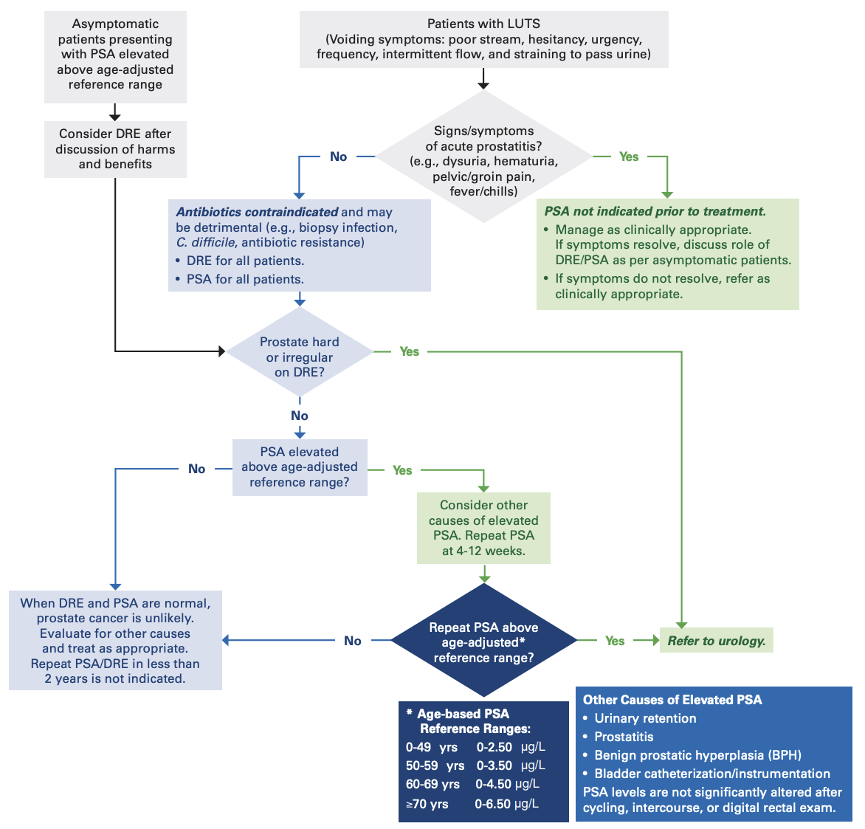
Patients with signs and symptoms of suspected prostate cancer
BCGuidelines.ca 2020
Notes:
Appendix B: Care Pathway I – Patients with Signs and Symptoms of Suspected Prostate Cancer

Slide 30
Prostate Cancer Screening – Striking a Balance
Screening reduces the risk of death from prostate cancer.
Screening causes harm: anxiety, infection/bleeding after biopsy, bladder/bowel/ sexual dysfunction after treatment.
The key is to find the correct balance
Shared decision making is the foundation of prostate cancer screening

Slide 31
Diagnostic process of prostate cancer
Starts with first line medicine and adequate prostate cancer screening
(In symptomatic patient, an increase PSA or suspicious metastatic process triggers urologist referral)

Slide 32
10-years life expectancy
Research suggests that clinical intuition for estimating comorbidity and life expectancy is poor. ¹⁻³
Physician ability to adequately identifying who would live > or < than 10y was correct 68.3% of the time.¹
Leung, 2012
Sammon, 2015
Jeldres, 2012

Slide 33
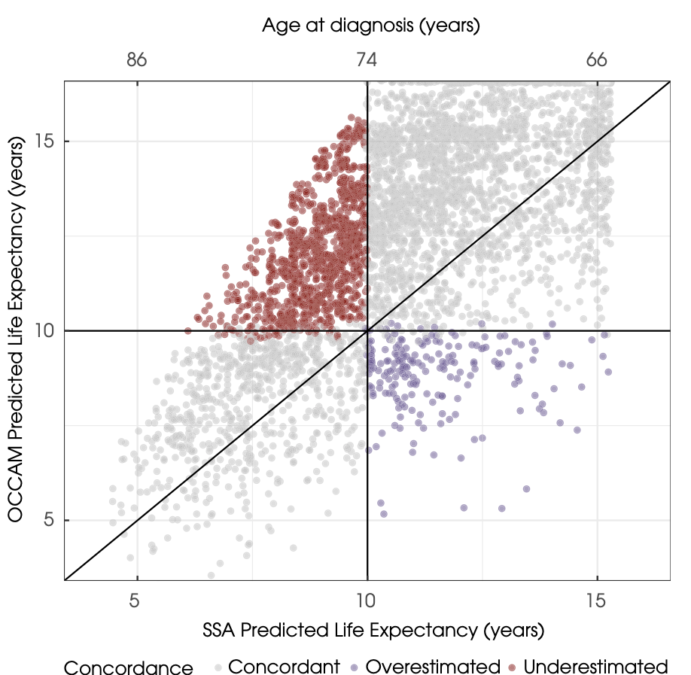
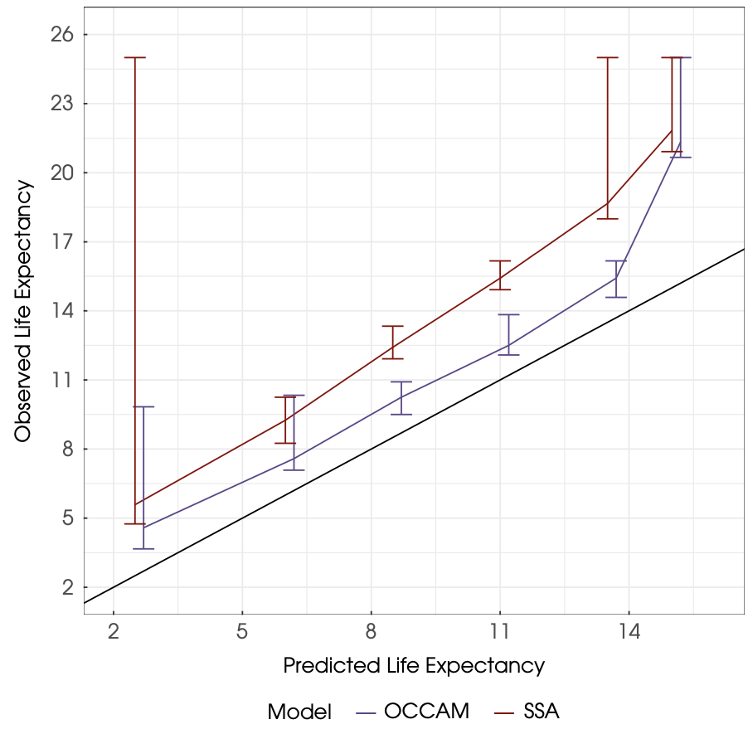
10 years life expectancy – OCCAM tools
In external validation, OCCAM had a cause-specific AUC of 0.75 at 10 years and 0.78 at 15 years
Slightly pessimism model (approximately 1.5 years) when validated in PLCO (possibly because healthier population)
Notes:
Our training data originated from the National Health and Nutrition Examination Survey (NHANES), a cross-sectional survey of demographics and health conducted biennially in the United States since 1999. NHANES is nationally representative of the US non-institutionalized civilian population [16]. Mortality follow-up on NHANES participants is provided through linkage with the National Death Index, with follow-up through to 31 December 2014. NHANES is not limited to prostate cancer patients, but instead represents the entire US population. We used NHANES data from 1999 to 2010 and restricted these to men older than 40 years with complete data for all covariates used in model building: age; race; educational attainment; marital status; veteran status; insurance status; diagnosis of anaemia, angina, arthritis, asthma, chronic bronchitis, coronary heart disease, congestive heart failure, diabetes, emphysema, high cholesterol, hypertension, kidney issues, liver disease, mental health concern or myocardial infarction; alcohol use; healthcare access; whether the patient had been hospitalized in the past year; body mass index (BMI); and smoking status. Men who reported having ever had a malignancy diagnosis other than prostate cancer were excluded.
Validation data with PLCO cohort of patient Dx with PCa with complete data

Slide 34
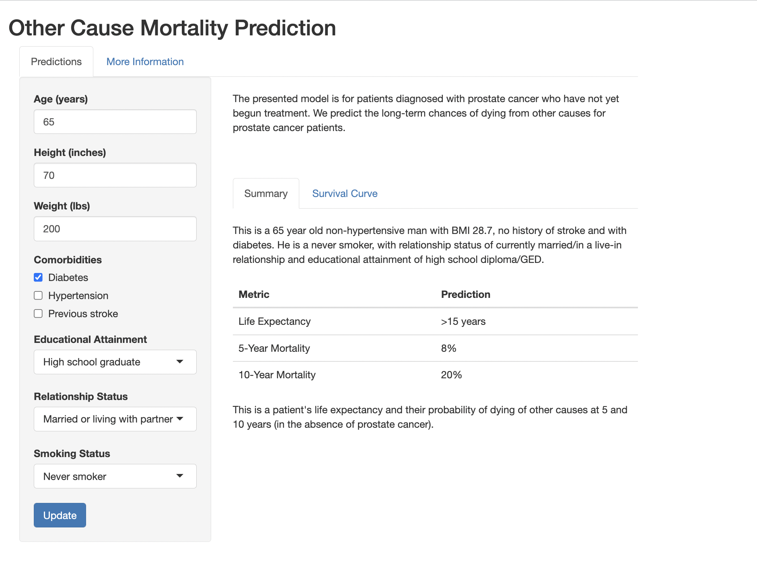
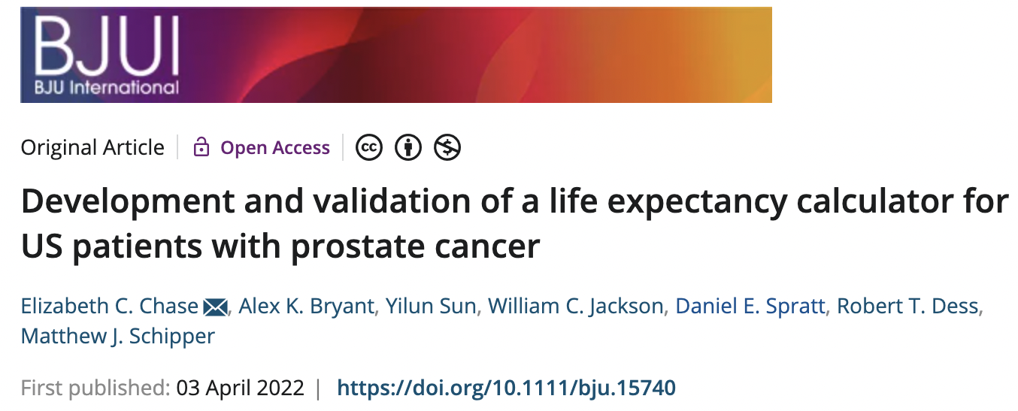
Other-Cause comorbidity-Adjusted Codel
Notes:
Our training data originated from the National Health and Nutrition Examination Survey (NHANES), a cross-sectional survey of demographics and health conducted biennially in the United States since 1999. NHANES is nationally representative of the US non-institutionalized civilian population [16]. Mortality follow-up on NHANES participants is provided through linkage with the National Death Index, with follow-up through to 31 December 2014. NHANES is not limited to prostate cancer patients, but instead represents the entire US population. We used NHANES data from 1999 to 2010 and restricted these to men older than 40 years with complete data for all covariates used in model building: age; race; educational attainment; marital status; veteran status; insurance status; diagnosis of anaemia, angina, arthritis, asthma, chronic bronchitis, coronary heart disease, congestive heart failure, diabetes, emphysema, high cholesterol, hypertension, kidney issues, liver disease, mental health concern or myocardial infarction; alcohol use; healthcare access; whether the patient had been hospitalized in the past year; body mass index (BMI); and smoking status. Men who reported having ever had a malignancy diagnosis other than prostate cancer were excluded.
Validation data with PLCO cohort of patient Dx with PCa with complete data

Slide 35
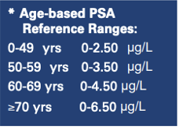
Recommendation for referral to urologist in context of PCa screening
Persistent increase of PSA (first step is to repeat PSA in 4-12 weeks)
No definitive cut-off value of PSA. Consideration of risks factors (BRCA, fam Hx)
Age-based PSA
BC cancer:
PSA velocity (or kinetics): < 0.75ng/ml/yr (not a perfect tool)
Abnormal DRE: request PSA and send referral.
In doubt: refer

Slide 37
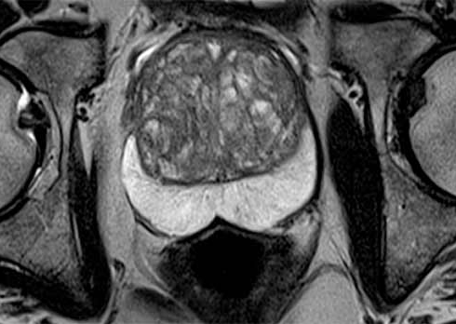
What about MRI?
Based on multiple trials, the role of MRI in the diagnosis of prostate cancer is rapidly evolving
Level 1 evidence suggests that MRI before biopsy increases the detection of Gl ≥3+4 prostate cancer
Biopsy of only MRI lesions reduces risk of detection of low-risk cancer
Access to high quality MRI remains an obstacle and consensus is that it should be request by urologist

Slide 38
Prostate biopsy
Transrectal approach
Transperineal approach

Slide 39
How can we decrease overtreatment?
Diagnosis
Risk Stratify
Treatment
Active surveillance for low risk and some intermediate risk prostate cancer

Slide 40
Does Gleason 6 progress (low/very low risk disease) ?
Ross et al., 2012
Eggener et al., 2011
14,000 men with Gleason 6
22 case of positive lymph nodes
After path review, they all had higher grade
12,000 men treated with radical prostatectomy with final path of gleason 6
Prostate cancer specific mortality: 0,2% at 20 yrs
After path review, they all had higher grade
10-20% of Gl 6 will progress after 10yr, but if remains Gl6, safe to conclude that metastatic potential of Gleason 6 alone is near null

Slide 41
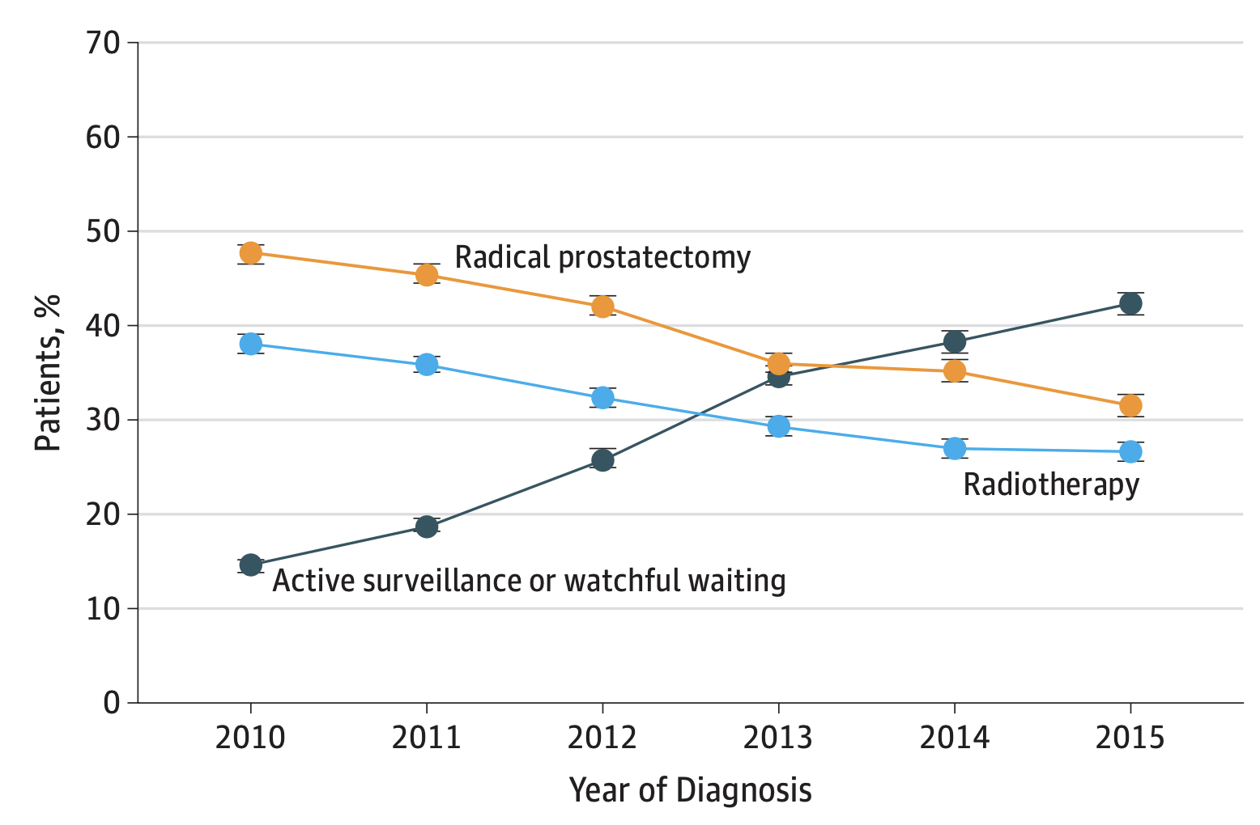
Trends in U.S.
BA Mahal et al., JAMA Feb 19, 2019 Volume 321, Number 7

Slide 42
Treatment options and follow up cares
Focus on localized prostate cancer

Slide 43
Patient Education is Key
Bowel function
Active Surveillance
Radiation
Endocrine function
Prostate Cancer
Bladder function
Androgen Deprivation
Radical Prostatectomy
Sexual function
Notes:
One of our main objectives in counseling a patient with a new diagnosis of prostate cancer is to educate the patient about the natural history of the disease.
When a patient is diagnosed with intermediate or high risk prostate cancer, the conversation turns to radiation vs surgery, and the focus is on selecting one or the other, proceeding with treatment and managing the side effects after surgery.
Our job is not to find an alternative quicker treatment, not to facilitate treatment in the US or elsewhere – but to educate the patient.
We know and accept that low risk PCa is suitable for AS – but as soon as we cross the arbitrary line to treat, everything becomes urgent.
Not all cancers are the same – survival times after different cancers.

Slide 44
Prostate Cancer Supportive Care Program
A comprehensive survivorship program for prostate cancer patients, their partners, and family from the time of initial diagnosis onwards
Introduction to Prostate Cancer & Primary Treatment Options
Managing the Impact of Prostate Cancer Treatment on Sexual Function and Intimacy
Lifestyle Management: Exercise and Nutrition
Recognition & Management of Treatment Related Side Effects of Androgen Deprivation Therapy (ADT)
Pelvic Floor Physiotherapy for Bladder and Bowel Concerns
Counselling Services
7. Metastatic Disease Management
*In-person and virtual education sessions and appointments available
Notes:
Module 1: newly dx patients w/ localized disease
Module 2: any patient w/ pca
Module 3: any patient w/ pca
Module 4: patients currently on, or about to start on ADT
Module 5: education session, any pt, clinic = must be 3mo after tx
Module 6: any patient w/ pca
Module 7: must be dx with metastatic disease
Most modules have both an education session and a one-on-one clinic
Modules 1 and 7 only have an education session
Module 6 only has a one-on-one clinic

Slide 45
Contact the PCSC Program
To Refer a Patient
Contact Us
Email pcsc@vch.ca with patient’s name and phone number
Patients can self-refer by calling us directly at 604-875-4485
Gordon & Leslie Diamond Health Care Centre Level 6, 2775 Laurel Street Vancouver, BC
pcsc@vch.ca
604-875-4485 Toll-free: 1-844-483-1449 Fax: 604-875-4637
www.pcscprogram.ca

Slide 46
TREATMENT OPTIONS FOR LOCALIZED PROSTATE CANCER
Active Surveillance
Prostatectomy
Radiation therapy

Slide 47
Treatment options according to RISK GROUPS
Risk | T stage, Gleason Group, PSA | Treatment options
Very low Or Low | T1-2 + Gleason 6+ PSA < 10 | Active surveillance, preferred (Prostatectomy or radiation are also options)
Intermediate | No high or very high-risk features + has one or more intermediate risk factors: T2b-c, Gleason 7, PSA 10-20 | Prostatectomy or Radiation +/- ADT +/- Brachy boost Active surveillance*
High | T3 OR Gleason 8-10 OR PSA > 20 | Prostatectomy or Radiation + ADT +/- Brachy boost
Notes:
RP either Robotic or Open is equivalent, as long as performed by trained specialist
RP equivalent of RT roughly, question of patients preferences and sides effect/ CI

Slide 48
Supplement Post-Treatment Issues

Slide 49
Important Post-Treatment Issues
Positive Surgical Margins
PSA
Urinary Function
Bowel Function
Sexual Health
Mental Health
Notes:
In terms of oncological outcomes the positive margin outcome of 15% are similar to that of large series of RP and RALP patients by Stephenson et al. J Urol 2009 who observed it to be 21%.
Note- positive margins were higher in 401-475 as pre-operative risk was much higher for these patients.

Slide 50
Adjuvant Radiation is indicated for most patients with positive margins
True
False

Slide 51
Positive Surgical Margins

Slide 52
Margins CAN be significant (or not)
Implications for adjuvant radiation (with associated toxicity)
3 RCTs favour adjuvant radiation over no radiation
3 more recent RCTs favour early salvage radiation over adjuvant RT

Slide 53
Biochemical Recurrence
BCGuidelines.ca
Notes:
Anything below is of low significance/concern.

Slide 54
Post-Treatment Sexual Dysfunction
Erectile dysfunction
Anejaculation
Anorgasmia
Dysorgasmia (painful)
Climacturia
Penile shortening
Penile curvature

Slide 55
Risk Factors for ED: Patient Factors
Age >60 yrs
Vascular disease
Diabetes
Dyslipidemia
Smoking
High stage of disease
Obesity
Assessment of a patient’s preoperative erectile function is important.
Include partner whenever possible in discussions of sexual rehabilitation after treatment.
Notes:
Picture of SHIM score questionnaire

Slide 56
Recovery of Erections According to Preoperative Sexual Functioning
Rabbani F, et al. J Urol. 2000;164:1929-1934.

Slide 57
Penile Rehabilitation
Easiest to implement
Men like to do something
Evidence for enhanced recovery is poor
Expensive
No real side effects
Awkward and sometimes uncomfortable
Maintains penile length
Like beneficial for later recovery
Most effective
Most invasive
Most men not interested in trying
Best evidence for enhancement of later recovery
PDE5 Inhibitors
Vacuum Pump
Intracavernosal injections

Slide 58
Urinary incontinence after radical prostatectomy
Large studies tell us: At ONE year postop:
Risk of any urinary leakage = 30%
Risk of bothersome urinary leakage = 10%
Risk of serious leakage requiring surgery = 1-2%
Notes:
Picture penile clamp
Kegel exercises
Pelvic floor physio

Slide 59
Risk Factors: Incontinence
Overactive bladder
Increased age
Prior radiotherapy
Prior TURP
Pre-operative incontinence
Surgical expertise
Urethral length

Slide 60
EBRT SIDE EFFECTS
Early side effects and risks
Late side effects and risks
Fatigue of varying degrees
Irritation of bowel and bladder (diarrhea and urinary frequency)
Loose stools can be addressed by dietary changes and anti-diarrheal medications
Symptoms usually recover within weeks after finishing radiation
Erectile dysfunction can occur ≥2 years after radiation, related to age and other health issues
Bladder complications (frequency, bleeding, urgency)
Rectal bleeding in small percentage

Slide 61
SIDE EFFECTS OF BRACHYTHERAPY
Urinary frequency, urgency, and pain for 2-6 months
5-10% may need urinary catheter for up to a few weeks, most 6-10d
30% have worse urinary function in long term
Urethral stricture 2%
Bowel frequency < 10%
Rectal bleeding 5%, medical management
1 in 1000 men develop bowel ulcer needing surgery
Gradual decline in erectile function – similar to RP after 2-3 years

Slide 62
Post-Treatment Mental Health
1 in 3 men with PCa experience clinically significant depression and/or anxiety.
1 in 6 men with prostate cancer are at risk for suicide.
Most men are not offered psychological support.
When offered, many decline.
Do not forget the spouse/partner!
Better screening for identification of mental health problems in men with PCa
Better support for bladder/ sexual dysfunction
Better support for partner
Better models of psych support for men that address male coping strategies
Evidence
Gap
Solution
Klaassen et al Urol Oncol 2017
Notes:
Men benefit more from psych support when they do take part
1:3 cancer is all cancer
1:6 suicide is Queens study of 240 men newly diagnosed (see poster image files)
Men turn to spouse but not outside help; this puts undue burden on spouse.

Slide 63
Prostate Cancer Summary
A critical review of the evidence suggests that PSA screening is beneficial in a subset of men (especially age 50-70, >10 yr life expectancy) and it should be discussed with men (shared decision making)
Active surveillance plays a critical role in care of low and favorable intermediate risk prostate cancer.
Although reducing risk of mortality from PCa, radical prostatectomy and radiation therapy both can have a major impact on sexual, bladder and bowel function. Patient support measures are critical to assist in management.
Do not forget mental health!

Slide 64
Questions ?

